Slide 1
Proximal Policy Optimization (PPO)
default reinforcement learning algorithm at OpenAI
Policy Gradient
On-policy $→$ Off-policy
On-policy → Off-policy
Add constraint
Notes:
https://www.youtube.com/watch?v=ycCtmp4hcUs&list=PLkFD6_40KJIznC9CDbVTjAF2oyt8_VAe3&index=14
http://rll.berkeley.edu/deeprlcourse/f17docs/lecture_4_policy_gradient.pdf
http://rll.berkeley.edu/deeprlcourse/f17docs/lecture_13_advanced_pg.pdf
Ref:http://rll.berkeley.edu/deeprlcourse/docs/lec5.pdf
Ref:http://www.cs.toronto.edu/~tingwuwang/trpo.pdf

Slide 2
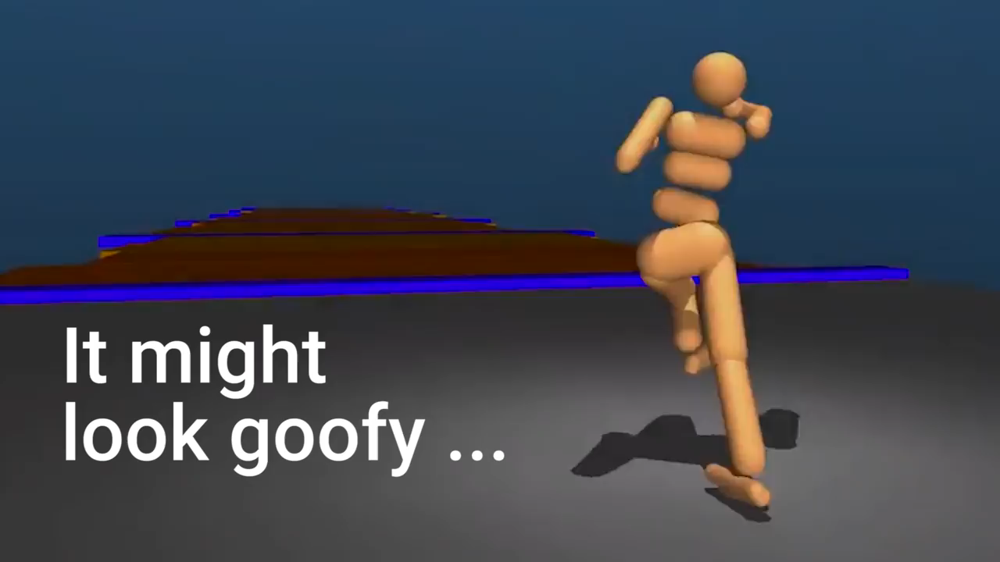
DeepMind
https://youtu.be/gn4nRCC9TwQ
Notes:
Deep mind

Slide 3
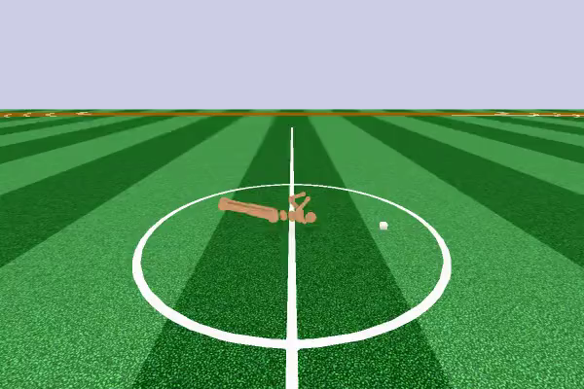
OpenAI
https://blog.openai.com/openai-baselines-ppo/
Notes:
openAI

Slide 4
Policy Gradient (Review)

Slide 5

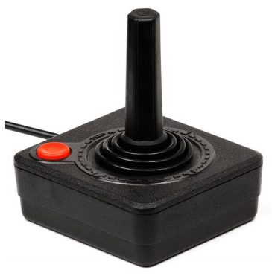
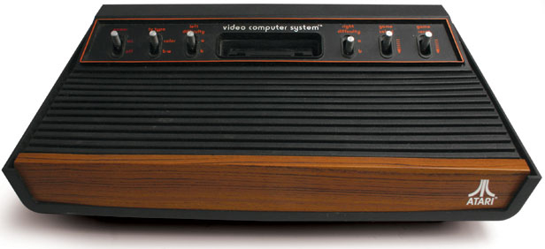

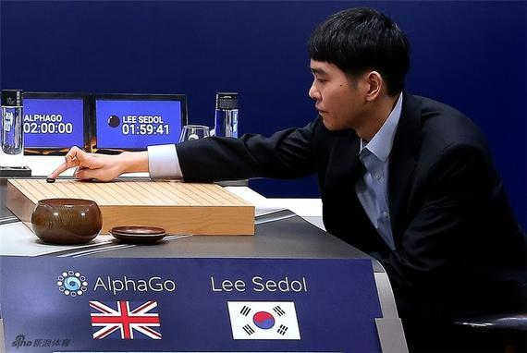
Basic Components
You cannot control
Actor
Env
Reward
Function
Video
Game
Get 20 scores when killing a monster
The rule of GO
Go

Slide 6

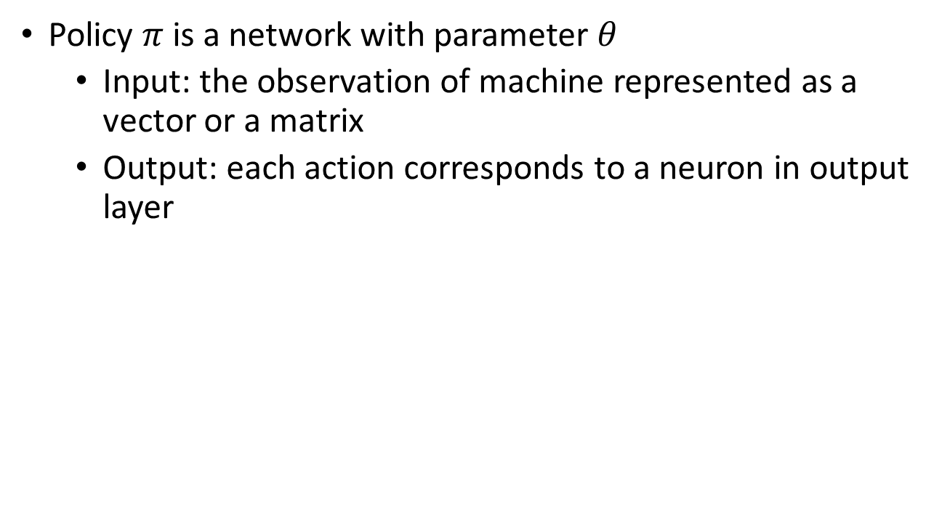
Policy of Actor
Policy $π$ is a network with parameter $θ$
Input: the observation of machine represented as a vector or a matrix
Output: each action corresponds to a neuron in output layer
Take the action based on the probability.
left
0.7
…
right
0.2
Score of an action
…
fire
0.1
pixels
Notes:
Taking the action with the highest score

Slide 7

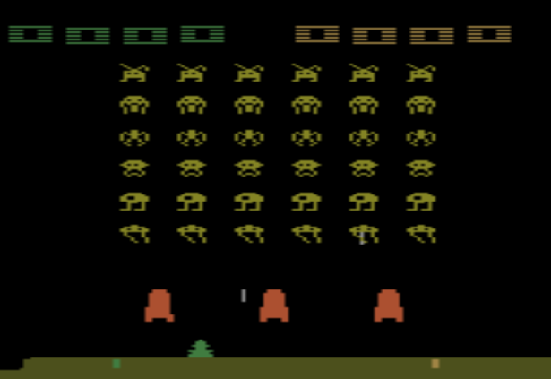

Example: Playing Video Game
Start with observation $s_{1}$
Observation $s_{2}$
Observation $s_{3}$
Obtain reward $r_{1}=0$
Obtain reward $r_{2}=5$
Action $a_{1}$: “right”
Action $a_{2}$: “fire”
(kill an alien)
Notes:
Usually there is some randomness in the environment

Slide 8

Example: Playing Video Game
Start with observation $s_{1}$
Observation $s_{2}$
Observation $s_{3}$
This is an episode.
After many turns
Total reward:
$$R=\sum_{t=1}^{T}{r_{t}}$$
Game Over
(spaceship destroyed)
Obtain reward $r_{T}$
We want the total reward be maximized.
Action $a_{T}$

Slide 9
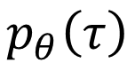
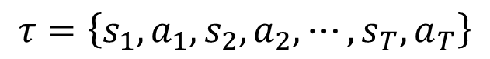
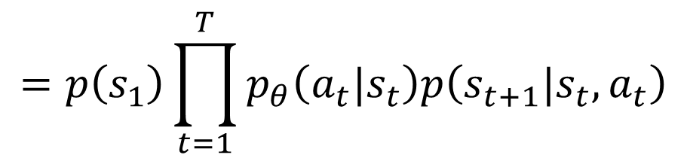
Actor, Environment, Reward
$$s_{1}$$
$$a_{1}$$
$$s_{2}$$
$$a_{2}$$
Env
Actor
Env
Actor
Env
……
$$s_{1}$$
$$a_{1}$$
$$s_{2}$$
$$a_{2}$$
$$s_{3}$$
Trajectory
$$τ=\left\{s_{1},a_{1}, s_{2},a_{2}, ⋯,s_{T},a_{T}\right\}$$
$$p_{θ}\left(τ\right)$$
$$=p\left(s_{1}\right)p_{θ}\left(a_{1}|s_{1}\right)p\left(s_{2}|s_{1},a_{1}\right)p_{θ}\left(a_{2}|s_{2}\right)p\left(s_{3}|s_{2},a_{2}\right)⋯$$
$$=p\left(s_{1}\right)\prod_{t=1}^{T}{p_{θ}\left(a_{t}|s_{t}\right)p\left(s_{t+1}|s_{t},a_{t}\right)}$$

Slide 10
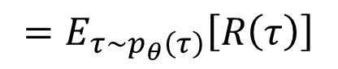
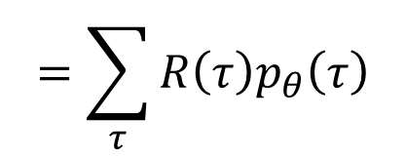
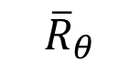
Actor, Environment, Reward
updated
updated
$$s_{1}$$
$$a_{1}$$
$$s_{2}$$
$$a_{2}$$
Env
Actor
Env
Actor
Env
……
$$s_{1}$$
$$a_{1}$$
$$s_{2}$$
$$a_{2}$$
$$s_{3}$$
Reward
Reward
$$r_{1}$$
$$r_{2}$$
Expected Reward
$$R\left(τ\right)=\sum_{t=1}^{T}{r_{t}}$$
$$=\sum_{τ}{R\left(τ\right)p_{θ}\left(τ\right)}$$
$${\overline{R}}_{θ}$$
$$=E_{τ\sim p_{θ}\left(τ\right)}\left[R\left(τ\right)\right]$$
Notes:
Ref: https://www.youtube.com/watch?v=W8XF3ME8G2I

Slide 11
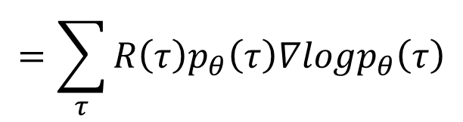
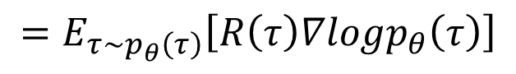
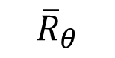
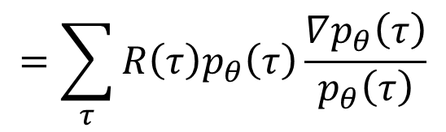
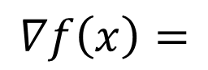
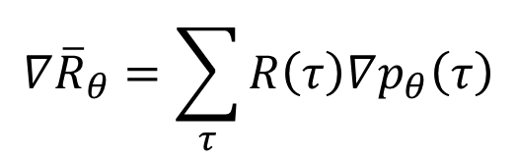
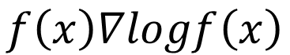
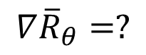
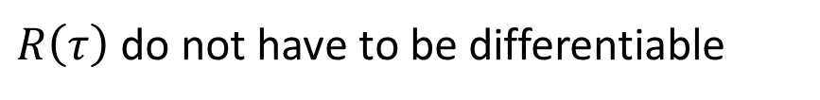
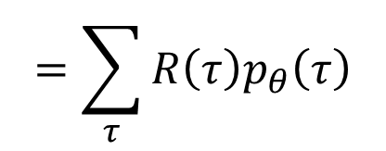
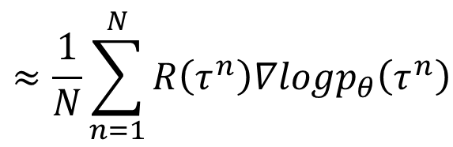
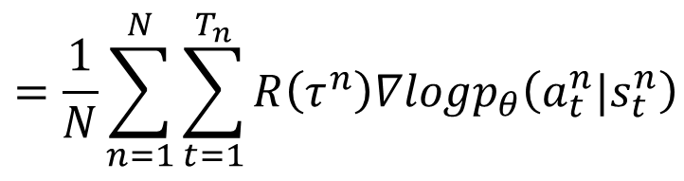
Policy Gradient
$$=\sum_{τ}{R\left(τ\right)p_{θ}\left(τ\right)}$$
$${\overline{R}}_{θ}$$
$$∇{\overline{R}}_{θ}=?$$
$$∇{\overline{R}}_{θ}=\sum_{τ}{R\left(τ\right)∇p_{θ}\left(τ\right)}$$
$$=\sum_{τ}{R\left(τ\right)p_{θ}\left(τ\right)\frac{∇p_{θ}\left(τ\right)}{p_{θ}\left(τ\right)}}$$
$R\left(τ\right)$ do not have to be differentiable
It can even be a black box.
$$∇f\left(x\right)=$$
$$=\sum_{τ}{R\left(τ\right)p_{θ}\left(τ\right)∇logp_{θ}\left(τ\right)}$$
$$f\left(x\right)∇logf\left(x\right)$$
$$≈\frac{1}{N}\sum_{n=1}^{N}{R\left(τ^{n}\right)∇logp_{θ}\left(τ^{n}\right)}$$
$$=E_{τ\sim p_{θ}\left(τ\right)}\left[R\left(τ\right)∇logp_{θ}\left(τ\right)\right]$$
$$=\frac{1}{N}\sum_{n=1}^{N}{\sum_{t=1}^{T_{n}}{R\left(τ^{n}\right)∇logp_{θ}\left(a_{t}^{n}|s_{t}^{n}\right)}}$$
Notes:
Use $π_{θ}$to play the game N times,
Obtain $\left\{τ^{1},τ^{2},⋯,τ^{N}\right\}$

Slide 12
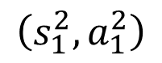
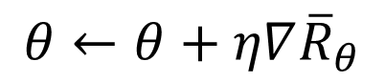
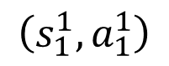
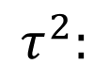

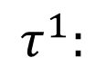
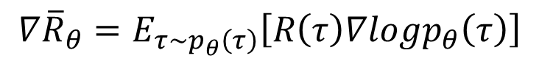
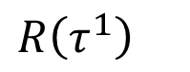
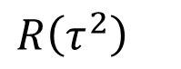
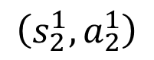
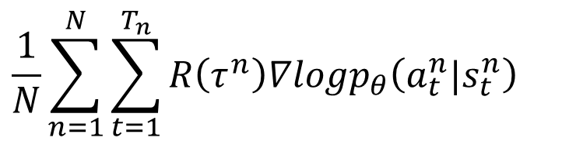
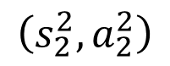
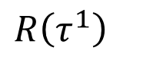
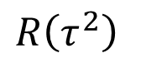
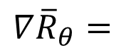
Policy Gradient
$$∇{\overline{R}}_{θ}=E_{τ\sim p_{θ}\left(τ\right)}\left[R\left(τ\right)∇logp_{θ}\left(τ\right)\right]$$
Update
Model
Given policy $π_{θ}$
$$τ^{1}:$$
$$\left(s_{1}^{1},a_{1}^{1}\right)$$
$$R\left(τ^{1}\right)$$
$$θ←θ+η∇{\overline{R}}_{θ}$$
$$\left(s_{2}^{1},a_{2}^{1}\right)$$
$$R\left(τ^{1}\right)$$
$$∇{\overline{R}}_{θ}=$$
……
……
$$\frac{1}{N}\sum_{n=1}^{N}{\sum_{t=1}^{T_{n}}{R\left(τ^{n}\right)∇logp_{θ}\left(a_{t}^{n}|s_{t}^{n}\right)}}$$
$$τ^{2}:$$
$$\left(s_{1}^{2},a_{1}^{2}\right)$$
$$R\left(τ^{2}\right)$$
$$\left(s_{2}^{2},a_{2}^{2}\right)$$
$$R\left(τ^{2}\right)$$
……
……
Data
Collection
only used once

Slide 13
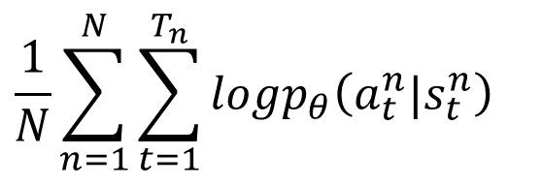
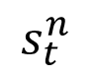
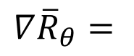
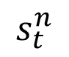
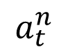
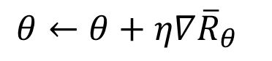
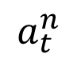
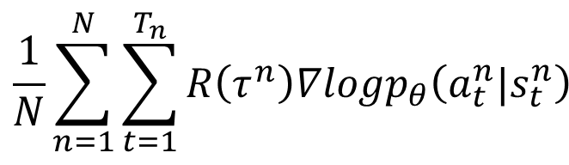
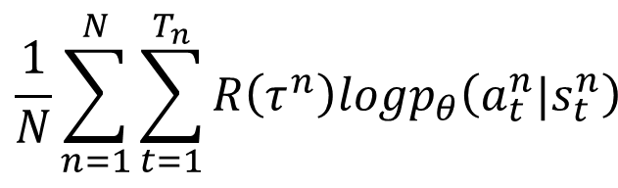
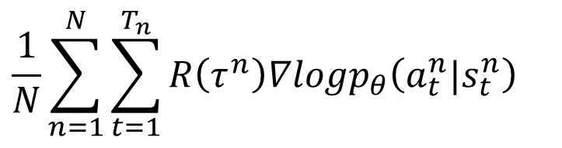
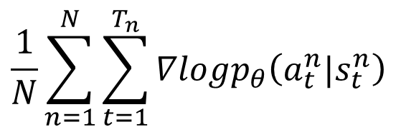

$$θ←θ+η∇{\overline{R}}_{θ}$$
Implementation
$$\frac{1}{N}\sum_{n=1}^{N}{\sum_{t=1}^{T_{n}}{R\left(τ^{n}\right)∇logp_{θ}\left(a_{t}^{n}|s_{t}^{n}\right)}}$$
$$∇{\overline{R}}_{θ}=$$
$$s_{t}^{n}$$
$$a_{t}^{n}$$
$$R\left(τ^{n}\right)$$
Consider as classification problem
left
1
$$a_{t}^{n}$$
…
right
0
…
$$s_{t}^{n}$$
fire
0
$$\frac{1}{N}\sum_{n=1}^{N}{\sum_{t=1}^{T_{n}}{logp_{θ}\left(a_{t}^{n}|s_{t}^{n}\right)}}$$
$$\frac{1}{N}\sum_{n=1}^{N}{\sum_{t=1}^{T_{n}}{∇logp_{θ}\left(a_{t}^{n}|s_{t}^{n}\right)}}$$
TF, pyTorch …
$$\frac{1}{N}\sum_{n=1}^{N}{\sum_{t=1}^{T_{n}}{R\left(τ^{n}\right)logp_{θ}\left(a_{t}^{n}|s_{t}^{n}\right)}}$$
$$\frac{1}{N}\sum_{n=1}^{N}{\sum_{t=1}^{T_{n}}{R\left(τ^{n}\right)∇logp_{θ}\left(a_{t}^{n}|s_{t}^{n}\right)}}$$

Slide 14





Tip 1: Add a Baseline
$$θ←θ+η∇{\overline{R}}_{θ}$$
It is possible that $R\left(τ^{n}\right)$ is always positive.
$$∇{\overline{R}}_{θ}≈\frac{1}{N}\sum_{n=1}^{N}{\sum_{t=1}^{T_{n}}{R\left(τ^{n}\right)∇logp_{θ}\left(a_{t}^{n}|s_{t}^{n}\right)}}$$
$$\frac{1}{N}\sum_{n=1}^{N}{\sum_{t=1}^{T_{n}}{\left(R\left(τ^{n}\right)−b\right)∇logp_{θ}\left(a_{t}^{n}|s_{t}^{n}\right)}}$$
$$b≈E\left[R\left(τ\right)\right]$$
It is probability …
Ideal
case
a
b
c
a
b
c
Not sampled
The probability of the actions not sampled will decrease.
Sampling
……
a
b
c
a
b
c

Slide 15




















Tip 2: Assign Suitable Credit
$$×−2$$
$$×−2$$
$$×−2$$
$$×−2$$
$$×3$$
$$×3$$
$$×3$$
$$×−7$$
$$×−7$$
$$×−7$$
$$\left(s_{a},a_{1}\right)$$
$$\left(s_{b},a_{2}\right)$$
$$\left(s_{c},a_{3}\right)$$
$$\left(s_{a},a_{2}\right)$$
$$\left(s_{b},a_{2}\right)$$
$$\left(s_{c},a_{3}\right)$$
+5
+0
-2
-5
+0
-2
$$R=+3$$
$$R=−7$$
$$∇{\overline{R}}_{θ}≈\frac{1}{N}\sum_{n=1}^{N}{\sum_{t=1}^{T_{n}}{\left(R\left(τ^{n}\right)−b\right)∇logp_{θ}\left(a_{t}^{n}|s_{t}^{n}\right)}}$$
$$\sum_{t^{′}=t}^{T_{n}}{r_{t^{′}}^{n}}$$

Slide 16






Tip 2: Assign Suitable Credit
How good it is if we take $a_{t}$other than other actions at $s_{t}$.
Advantage Function
$$A^{θ}\left(s_{t},a_{t}\right)$$
Estimated by “critic” (later)
Can be state-dependent
$$∇{\overline{R}}_{θ}≈\frac{1}{N}\sum_{n=1}^{N}{\sum_{t=1}^{T_{n}}{\left(R\left(τ^{n}\right)−b\right)∇logp_{θ}\left(a_{t}^{n}|s_{t}^{n}\right)}}$$
$$\sum_{t^{′}=t}^{T_{n}}{r_{t^{′}}^{n}}$$
$$\sum_{t^{′}=t}^{T_{n}}{γ^{t^{′}−t}r_{t^{′}}^{n}}$$
Add discount factor
$$γ<1$$

Slide 17
From on-policy to off-policy
Using the experience more than once

Slide 18


On-policy v.s. Off-policy
On-policy: The agent learned and the agent interacting with the environment is the same.
Off-policy: The agent learned and the agent interacting with the environment is different.
阿光下棋
佐為下棋、阿光在旁邊看

Slide 19











On-policy $→$ Off-policy
$$∇{\overline{R}}_{θ}=E_{τ\sim p_{θ}\left(τ\right)}\left[R\left(τ\right)∇logp_{θ}\left(τ\right)\right]$$
Use $π_{θ}$ to collect data. When $θ$ is updated, we have to sample training data again.
Goal: Using the sample from $π_{θ^{′}}$ to train $θ$. $θ^{′}$ is fixed, so we can re-use the sample data.
Importance Sampling
$x^{i}$ is sampled from $p\left(x\right)$
$$≈\frac{1}{N}\sum_{i=1}^{N}{f\left(x^{i}\right)}$$
$$E_{x\sim p}[f\left(x\right)]$$
We only have $x^{i}$ sampled from $q\left(x\right)$
$$=\int{f\left(x\right)p\left(x\right)dx}$$
$$=\int{f\left(x\right)\frac{p\left(x\right)}{q\left(x\right)}q\left(x\right)dx}$$
$$=E_{x\sim q}[f\left(x\right)\frac{p\left(x\right)}{q\left(x\right)}]$$
Importance weight

Slide 20







Issue of Importance Sampling
$$E_{x\sim p}[f\left(x\right)]=E_{x\sim q}[f\left(x\right)\frac{p\left(x\right)}{q\left(x\right)}]$$
$$VAR\left[X\right]$$
$${Var}_{x\sim p}[f\left(x\right)]≠{Var}_{x\sim q}[f\left(x\right)\frac{p\left(x\right)}{q\left(x\right)}]$$
$$=E\left[X^{2}\right]−{\left(E\left[X\right]\right)}^{2}$$
$${Var}_{x\sim p}\left[f\left(x\right)\right]=E_{x\sim p}\left[{f\left(x\right)}^{2}\right]−{\left(E_{x\sim p}\left[f\left(x\right)\right]\right)}^{2}$$
$${Var}_{x\sim q}[f\left(x\right)\frac{p\left(x\right)}{q\left(x\right)}]$$
$$=E_{x\sim q}\left[{\left(f\left(x\right)\frac{p\left(x\right)}{q\left(x\right)}\right)}^{2}\right]−{\left(E_{x\sim q}\left[f\left(x\right)\frac{p\left(x\right)}{q\left(x\right)}\right]\right)}^{2}$$
$$=E_{x\sim p}\left[{f\left(x\right)}^{2}\frac{p\left(x\right)}{q\left(x\right)}\right]−{\left(E_{x\sim p}\left[f\left(x\right)\right]\right)}^{2}$$

Slide 21






Issue of Importance Sampling
$$E_{x\sim p}[f\left(x\right)]=E_{x\sim q}[f\left(x\right)\frac{p\left(x\right)}{q\left(x\right)}]$$
$E_{x\sim p}\left[f\left(x\right)\right]$ is negative
$$f\left(x\right)$$
$$p\left(x\right)$$
$$q\left(x\right)$$
Very large weight
$E_{x\sim p}\left[f\left(x\right)\right]$ is positive?
negative

Slide 22



On-policy $→$ Off-policy
$$∇{\overline{R}}_{θ}=E_{τ\sim p_{θ}\left(τ\right)}\left[R\left(τ\right)∇logp_{θ}\left(τ\right)\right]$$
Use $π_{θ}$ to collect data. When $θ$ is updated, we have to sample training data again.
Goal: Using the sample from $π_{θ^{′}}$ to train $θ$. $θ^{′}$ is fixed, so we can re-use the sample data.
$$∇{\overline{R}}_{θ}=E_{τ\sim p_{θ^{′}}\left(τ\right)}\left[\frac{p_{θ}\left(τ\right)}{p_{θ^{′}}\left(τ\right)}R\left(τ\right)∇logp_{θ}\left(τ\right)\right]$$
Sample the data from $θ^{′}$.
Use the data to train $θ$ many times.
Importance Sampling
$$=E_{x\sim q}[f\left(x\right)\frac{p\left(x\right)}{q\left(x\right)}]$$
$$E_{x\sim p}[f\left(x\right)]$$

Slide 23







On-policy $→$ Off-policy
Gradient for update
$$∇f\left(x\right)=$$
$$f\left(x\right)∇logf\left(x\right)$$
$$=E_{\left(s_{t},a_{t}\right)\sim π_{θ}}[A^{θ}\left(s_{t},a_{t}\right)∇logp_{θ}\left(a_{t}^{n}|s_{t}^{n}\right)]$$
This term is from sampled data.
$$A^{θ^{′}}\left(s_{t},a_{t}\right)$$
$$=E_{\left(s_{t},a_{t}\right)\sim π_{θ^{′}}}[\frac{P_{θ}\left(s_{t},a_{t}\right)}{P_{θ^{′}}\left(s_{t},a_{t}\right)}A^{θ}\left(s_{t},a_{t}\right)∇logp_{θ}\left(a_{t}^{n}|s_{t}^{n}\right)]$$
$$=E_{\left(s_{t},a_{t}\right)\sim π_{θ^{′}}}[\frac{p_{θ}\left(a_{t}|s_{t}\right)}{p_{θ^{′}}\left(a_{t}|s_{t}\right)}\frac{p_{θ}\left(s_{t}\right)}{p_{θ^{′}}\left(s_{t}\right)}A^{θ}\left(s_{t},a_{t}\right)∇logp_{θ}\left(a_{t}^{n}|s_{t}^{n}\right)]$$
$$E_{\left(s_{t},a_{t}\right)\sim π_{θ^{′}}}\left[\frac{p_{θ}\left(a_{t}|s_{t}\right)}{p_{θ^{′}}\left(a_{t}|s_{t}\right)}A^{θ^{′}}\left(s_{t},a_{t}\right)\right]$$
$$J^{θ^{′}}\left(θ\right)=$$
When to stop?

Slide 24
Add Constraint
穩紮穩打，步步為營
Notes:
go ahead steadily

Slide 25









PPO / TRPO
$θ$ cannot be very different from $θ^{′}$
Constraint on behavior not parameters
Proximal Policy Optimization (PPO)
$$∇f\left(x\right)=$$
$$f\left(x\right)∇logf\left(x\right)$$
$$J_{PPO}^{θ^{′}}\left(θ\right)=J^{θ^{′}}\left(θ\right)−βKL\left(θ,θ^{′}\right)$$
$$E_{\left(s_{t},a_{t}\right)\sim π_{θ^{′}}}\left[\frac{p_{θ}\left(a_{t}|s_{t}\right)}{p_{θ^{′}}\left(a_{t}|s_{t}\right)}A^{θ^{′}}\left(s_{t},a_{t}\right)\right]$$
$$J^{θ^{′}}\left(θ\right)=$$
TRPO (Trust Region Policy Optimization)
$$E_{\left(s_{t},a_{t}\right)\sim π_{θ^{′}}}\left[\frac{p_{θ}\left(a_{t}|s_{t}\right)}{p_{θ^{′}}\left(a_{t}|s_{t}\right)}A^{θ^{′}}\left(s_{t},a_{t}\right)\right]$$
$$J_{TRPO}^{θ^{′}}\left(θ\right)=$$
$$KL\left(θ,θ^{′}\right)<δ$$

Slide 26




PPO algorithm
$$J^{θ^{k}}\left(θ\right)≈$$
$$\sum_{\left(s_{t},a_{t}\right)}{\frac{p_{θ}\left(a_{t}|s_{t}\right)}{p_{θ^{k}}\left(a_{t}|s_{t}\right)}}A^{θ^{k}}\left(s_{t},a_{t}\right)$$
Initial policy parameters $θ^{0}$
In each iteration
Using $θ^{k}$ to interact with the environment to collect $\left\{s_{t},a_{t}\right\}$ and compute advantage $A^{θ^{k}}\left(s_{t},a_{t}\right)$
Find $θ$ optimizing $J_{PPO}\left(θ\right)$
If $KL\left(θ,θ^{k}\right)>{KL}_{max}$, increase $β$
If $KL\left(θ,θ^{k}\right)<{KL}_{min}$, decrease $β$
Update parameters several times
$$J_{PPO}^{θ^{k}}\left(θ\right)=J^{θ^{k}}\left(θ\right)−βKL\left(θ,θ^{k}\right)$$
Adaptive KL Penalty

Slide 27











PPO algorithm
$$J_{PPO}^{θ^{k}}\left(θ\right)=J^{θ^{k}}\left(θ\right)−βKL\left(θ,θ^{k}\right)$$
$$J^{θ^{k}}\left(θ\right)≈\sum_{\left(s_{t},a_{t}\right)}{\frac{p_{θ}\left(a_{t}|s_{t}\right)}{p_{θ^{k}}\left(a_{t}|s_{t}\right)}}A^{θ^{k}}\left(s_{t},a_{t}\right)$$
PPO2 algorithm
$$≈\sum_{\left(s_{t},a_{t}\right)}{min\left(\frac{p_{θ}\left(a_{t}|s_{t}\right)}{p_{θ^{k}}\left(a_{t}|s_{t}\right)}A^{θ^{k}}\left(s_{t},a_{t}\right),clip\left(\frac{p_{θ}\left(a_{t}|s_{t}\right)}{p_{θ^{k}}\left(a_{t}|s_{t}\right)},1−ε,1+ε\right)A^{θ^{k}}\left(s_{t},a_{t}\right)\right)}$$
$$J_{PPO2}^{θ^{k}}\left(θ\right)$$
$$≈\sum_{\left(s_{t},a_{t}\right)}{min\left(clip\left(\frac{p_{θ}\left(a_{t}|s_{t}\right)}{p_{θ^{k}}\left(a_{t}|s_{t}\right)},1−ε,1+ε\right)A^{θ^{k}}\left(s_{t},a_{t}\right)\right)}$$
$$1+ε$$
$$1$$
$$1−ε$$
$$\frac{p_{θ}\left(a_{t}|s_{t}\right)}{p_{θ^{k}}\left(a_{t}|s_{t}\right)}$$
$$1−ε$$
$$1$$
$$1+ε$$

Slide 28








PPO algorithm
$$J_{PPO}^{θ^{k}}\left(θ\right)=J^{θ^{k}}\left(θ\right)−βKL\left(θ,θ^{k}\right)$$
$$J^{θ^{k}}\left(θ\right)≈\sum_{\left(s_{t},a_{t}\right)}{\frac{p_{θ}\left(a_{t}|s_{t}\right)}{p_{θ^{k}}\left(a_{t}|s_{t}\right)}}A^{θ^{k}}\left(s_{t},a_{t}\right)$$
PPO2 algorithm
$$≈\sum_{\left(s_{t},a_{t}\right)}{min\left(\frac{p_{θ}\left(a_{t}|s_{t}\right)}{p_{θ^{k}}\left(a_{t}|s_{t}\right)}A^{θ^{k}}\left(s_{t},a_{t}\right),clip\left(\frac{p_{θ}\left(a_{t}|s_{t}\right)}{p_{θ^{k}}\left(a_{t}|s_{t}\right)},1−ε,1+ε\right)A^{θ^{k}}\left(s_{t},a_{t}\right)\right)}$$
$$J_{PPO2}^{θ^{k}}\left(θ\right)$$
$$≈\sum_{\left(s_{t},a_{t}\right)}{min\left(clip\left(\frac{p_{θ}\left(a_{t}|s_{t}\right)}{p_{θ^{k}}\left(a_{t}|s_{t}\right)},1−ε,1+ε\right)A^{θ^{k}}\left(s_{t},a_{t}\right)\right)}$$
$$A>0$$
$$A<0$$
$$1+ε$$
$$1+ε$$
$$1$$
$$1$$
$$1−ε$$
$$1−ε$$
$$1−ε$$
$$1$$
$$1+ε$$
$$1−ε$$
$$1$$
$$1+ε$$

Slide 29

Experimental Results
https://arxiv.org/abs/1707.06347

